Slide 1
Smart Water Consumption Monitoring & Leak Detection
A Data-Driven Approach to Detect Leaks and Optimize Water Supply
Presented by: Rohini Hiremath
Date: [25/5/2025]

Slide 2
Objective
Monitor water usage trends using smart meter data.
Detect anomalies indicating leaks or misuse.
Optimize water supply with consumption insights.
Leverage ML and dashboards for automation.

Slide 3
Problem Statement
Water scarcity affects millions globally.
30–40% of urban water lost due to leaks and mismanagement.
Traditional detection methods are inefficient.
Need for real-time, automated leak detection.

Slide 4
Methodology Overview
1. Data Collection
2. MySQL Database Design
3. Exploratory Data Analysis
4. Dashboard Creation (Power BI)
5. Insights & Recommendations

Slide 5
Data Collection
• Sources: Smart meters, weather APIs, population data.
• Metrics: Consumption (L), pressure (bar), temperature, rainfall.
• Example Record:
| Date | Household ID | Consumption | Pressure | Temp | Rainfall |
|------|--------------|-------------|----------|------|----------|
| 2025-05-01 | 102 | 430 L | 3.2 bar | 30.5°C | 0 mm |

Slide 6
MySQL Database Design
• Tables: household_usage, pipeline_maintenance, weather_data, demographics.
• Relationships:
- household_usage linked to demographics and weather_data.
- maintenance logs tied to location ID.
[Insert ER Diagram or Schema Visual here]

Slide 7
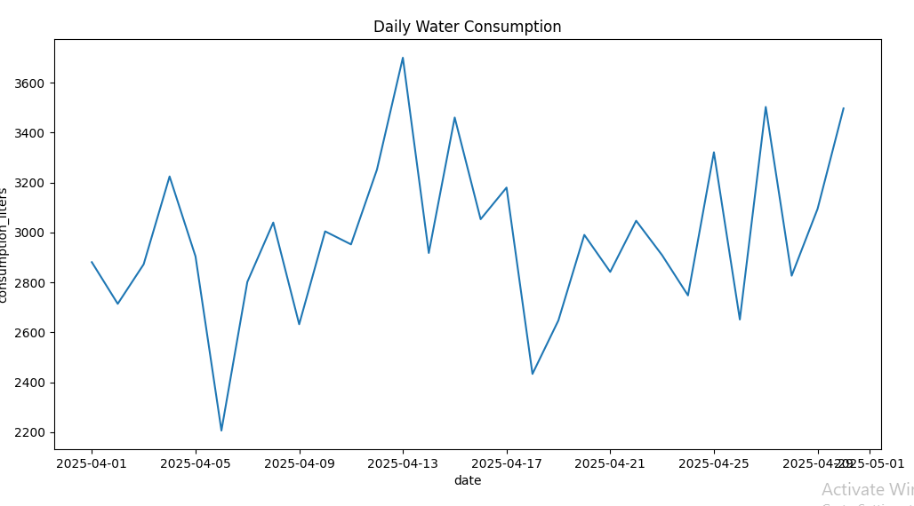
Exploratory Data Analysis (EDA)
“Daily Water Consumption Over 30 Days”

Slide 8
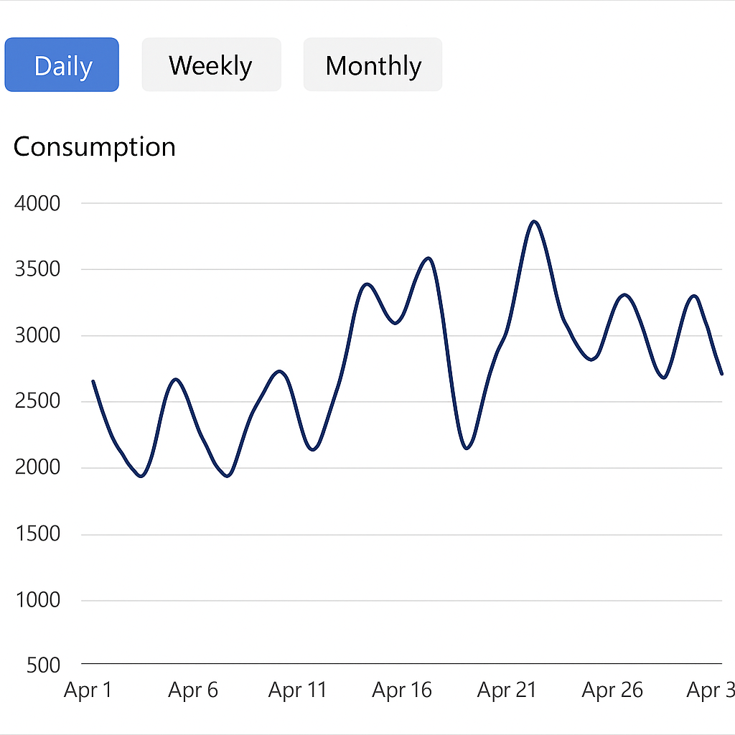
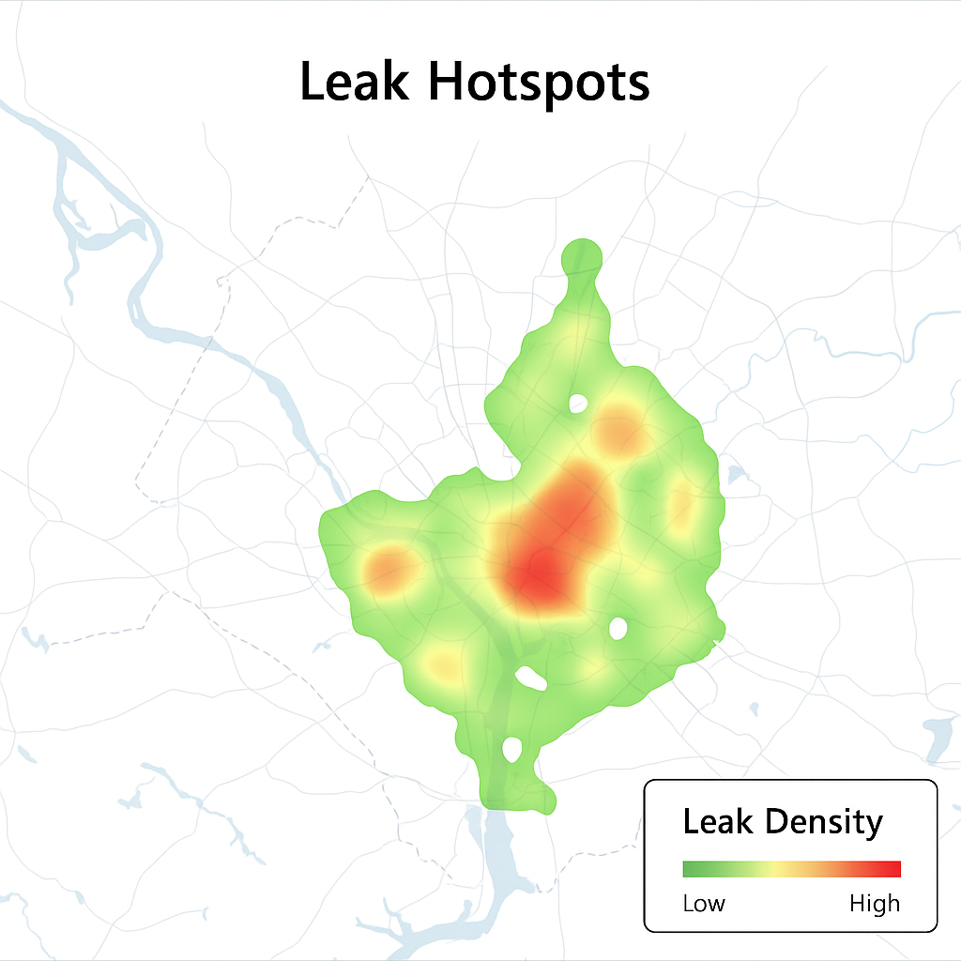
Power BI Dashboard
• Features:
- Line graphs: Daily/weekly/monthly usage.
- Heatmaps: Geographical leak hotspots.

Slide 9
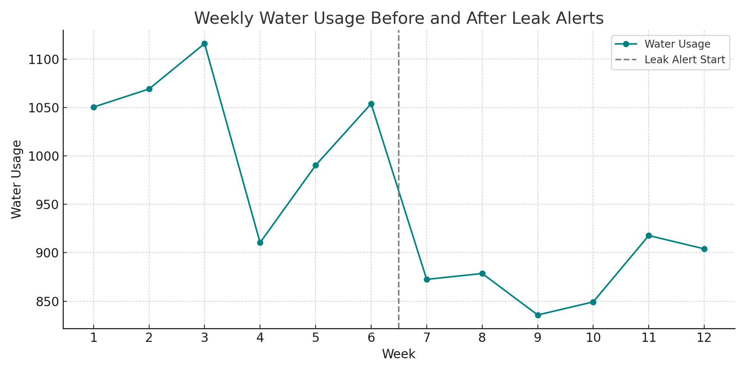
Results & Findings
42 potential leaks found in 3 months.
• 12% reduction in water usage post-alerts.
• Repair response time improved by 40%.

Slide 10
Recommendations
• Install smart meters city-wide.
• Send automated alerts for abnormal usage.
• Plan preventive maintenance in risky zones.
• Conduct public awareness campaigns.

Slide 11
Conclusion
End-to-end solution for water management.
ML helps predict and prevent leaks.
Future scope:
- Deep learning models
- Real-time GIS dashboards
- Mobile alerts for users

Slide 12


